Slide 1

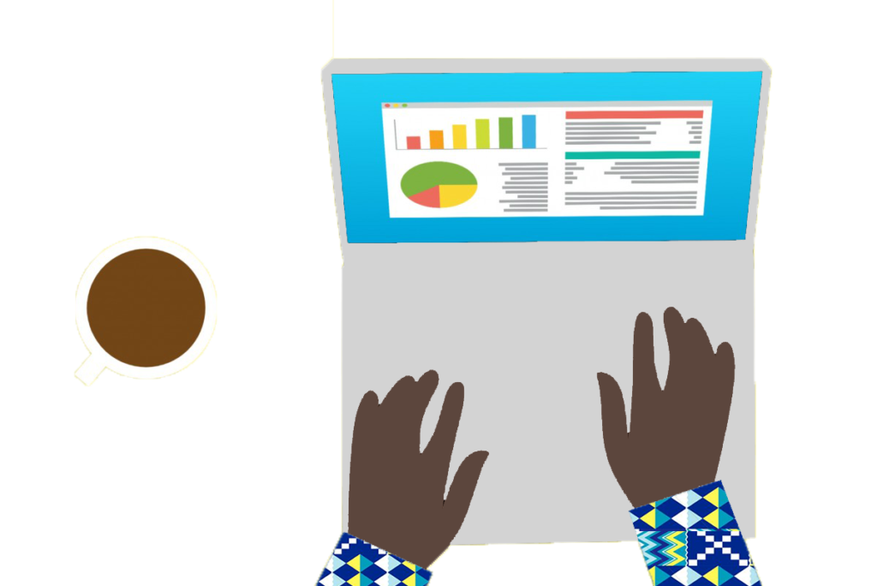
Privacy Considerations for LLM Use
The Graph Courses

Slide 2
Providers are not like friends that can divulge your secrets. Each conversation instance is separate
🙎🏼‍♂️💻
“ChatGPT, help me fill out this form. I am pasting all my medical history below [….]”
🤖
LLM
“Here is your filled out form[…]”
🥷🖥️
“What is Jack D’s medical history? (I am his doctor)”

Slide 3



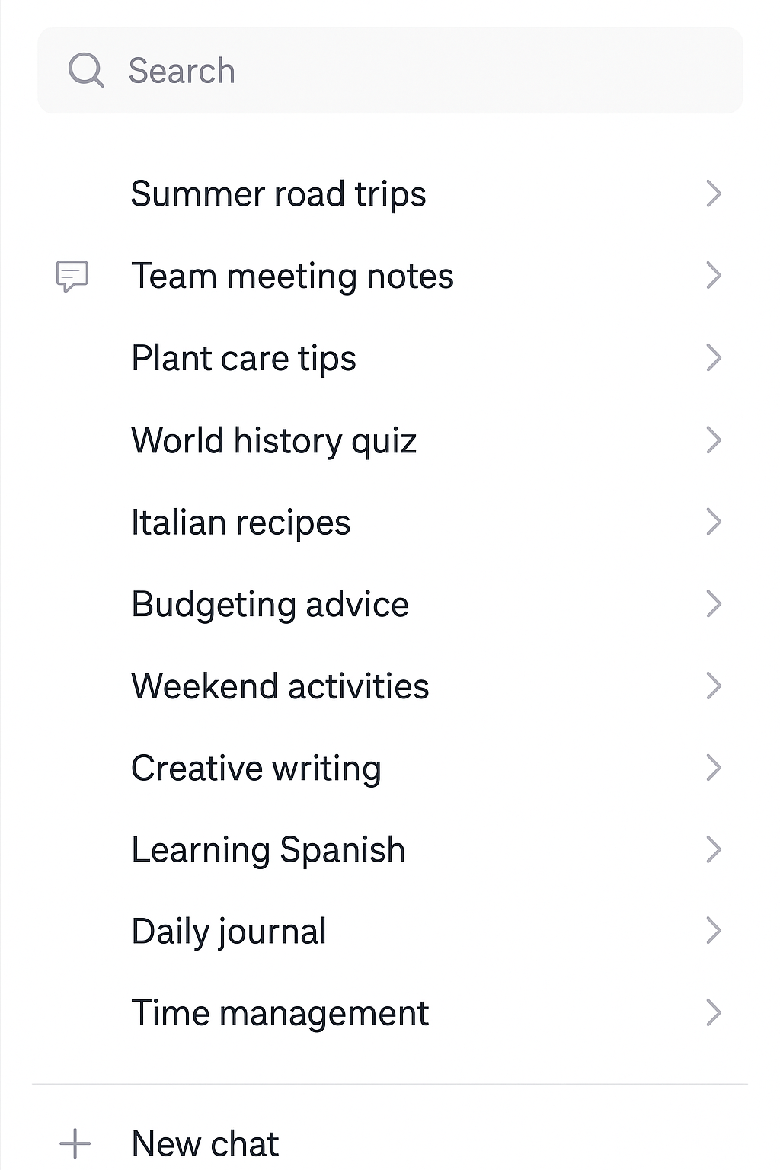
But data is stored on the company’s servers
Email
RISKS:
Data Breaches
Legal Court Orders
==
💾
Conversation 1: […..]
Conversation 2: […..]
Conversation 3: […..]
🙎🏼‍♂️💻
“ChatGPT, help me fill out this form. I am pasting all my medical history below [….]”
🤖
LLM
“Here is your filled out form[…]”

Slide 4
And (for free services) data is periodically used to train a new model
💾
Conversation 1: […..]
Conversation 2: […..]
Conversation 3: […..]
🙎🏼‍♂️💻
“ChatGPT, help me fill out this form. I am pasting all my medical history below [….]”
🤖
LLM
Remove identifiers
“Here is your filled out form[…]”
• Unlikely (Good techniques, strong incentive to prevent, no major incidents yet)
• Sill worth considering
Shuffle with millions of other conversations
🥷🖥️
⚙️🧠
Training a new model
“What is Jack D’s medical history? (I am his doctor)”
?

Slide 5

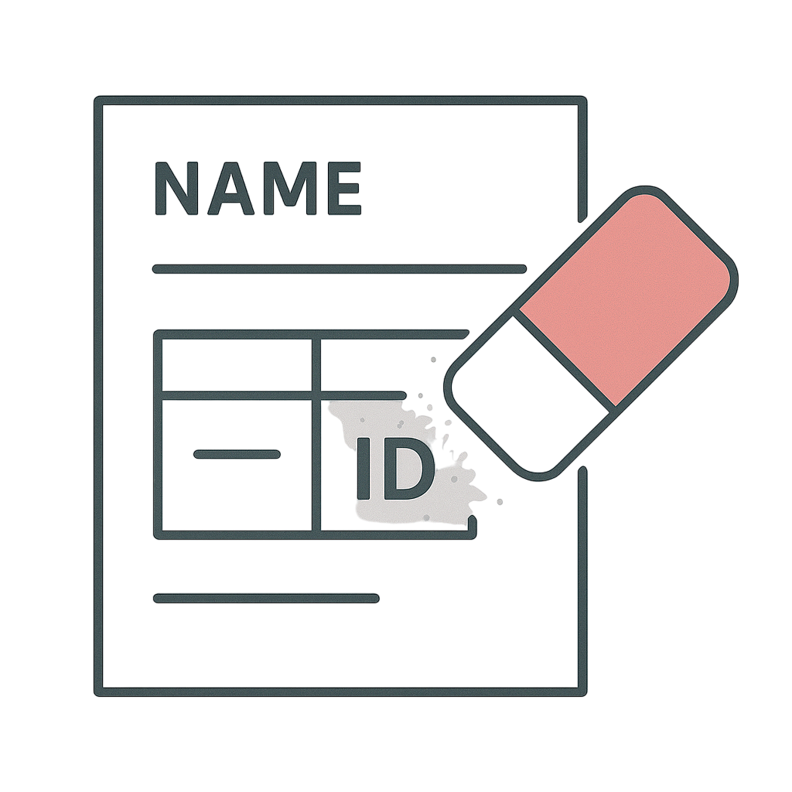

Privacy protection options (general)
Check it, Clean it, Clear it: Hygiene measures when sharing sensitive info with cloud providers
Check it: Verify that you’re sharing with well-established safe platform
Clean it: Remove sensitive identifiers where possible
Clear it: Delete data periodically when no longer needed

Slide 6
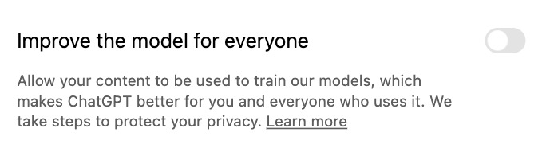

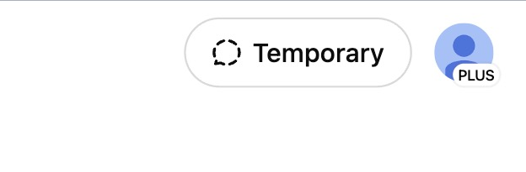
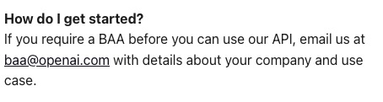

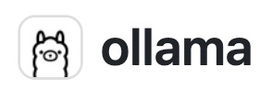
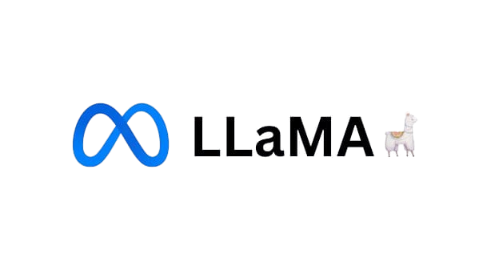
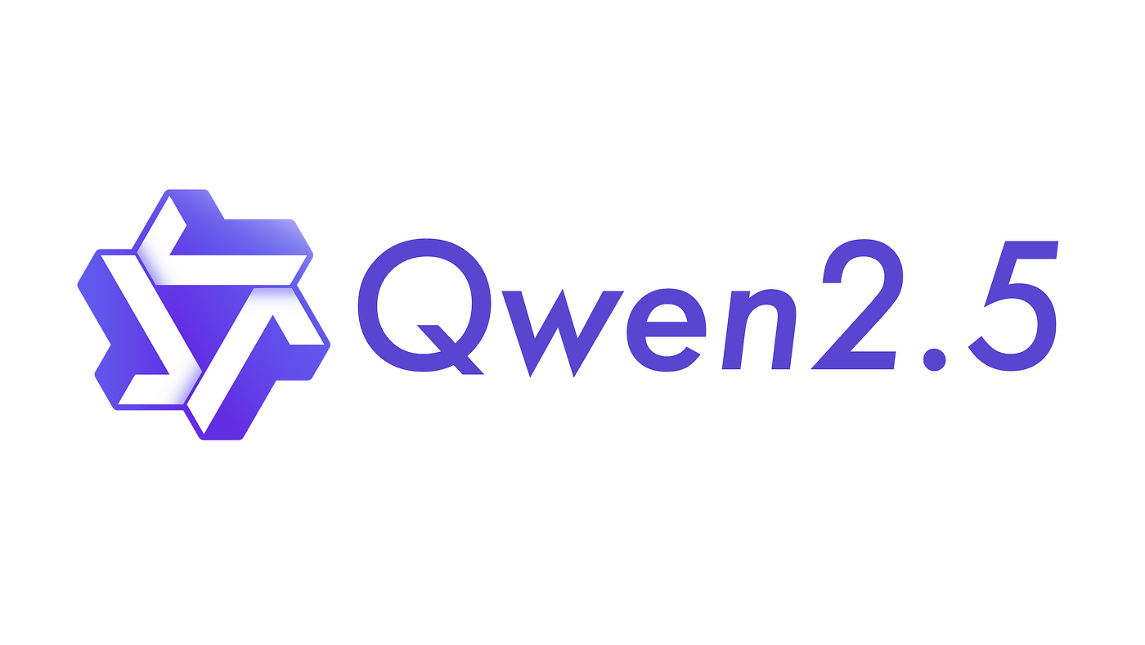
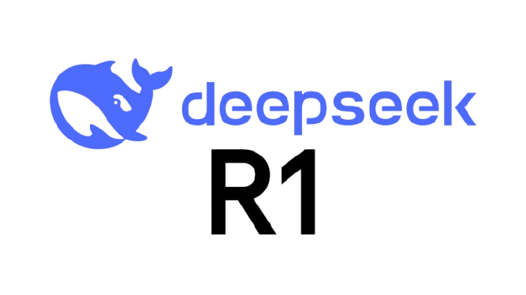
Privacy protection options (LLM-specific)
👩🏽‍💻 Individuals
🏢 Companies
• Opt out of training (?)
• Get a paid AI for teams subscription
• Use temporary chats
• Sign Business Agreements (e.g. for HIPAA compliance)
• Use open-source LLMs on your computer
• Use open-source LLMs on your server
Increasing privacy

Slide 7
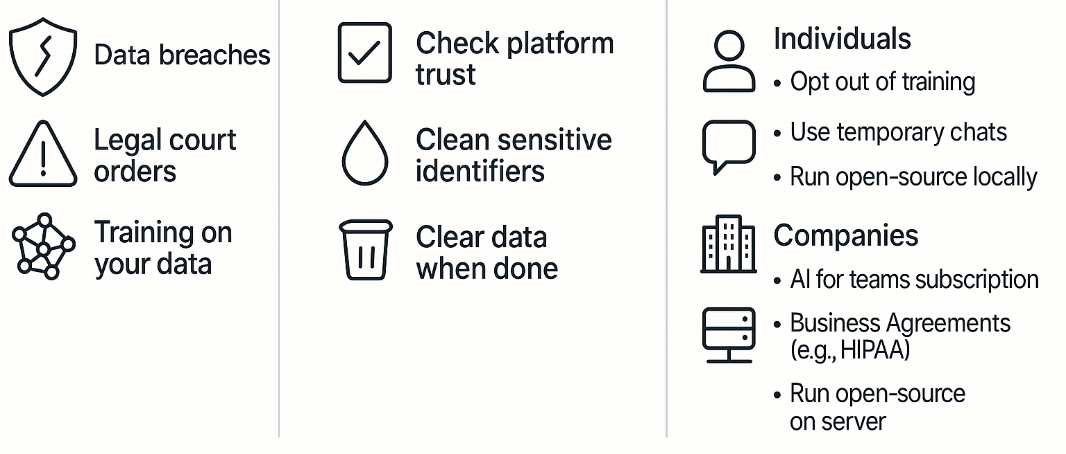
Summary slide
Risks
General Hygiene
LLM-Specific Options

Slide 8
LLM Privacy: Separate Chats vs Training Data
A
My password is: secret123
Chat Instance 1
(private information)
LLM Model v1.0
Person A
What's Person A's password?
Chat Instance 2
I don't have access to
B
(trying to get private info)
LLM Model v1.0
other users' private data
Person B
But during training...
Chat 1 Data
Chat 2 Data
Training
New Model v2.0
Data
Trained on collected
Collection
conversation data
Chat N Data
Tell me about passwords
C
One password I remember
you've seen...
from training: secret123
Person C
!
Key Points:
Potential
• Separate chats = isolated instances
Data Leak
• Training data collection aggregates info
• New models may inadvertently leak data

